Slide 1

CHARACTERISTICS OF PAKISTANI CULTURE
GROUP MEMBERS:
USAMA MAHTAB
SHAH ABDUL HAYEE
HUZAIFA WAHEED ABBASI
SYED M. FAZIL
Presentation Design

Slide 2
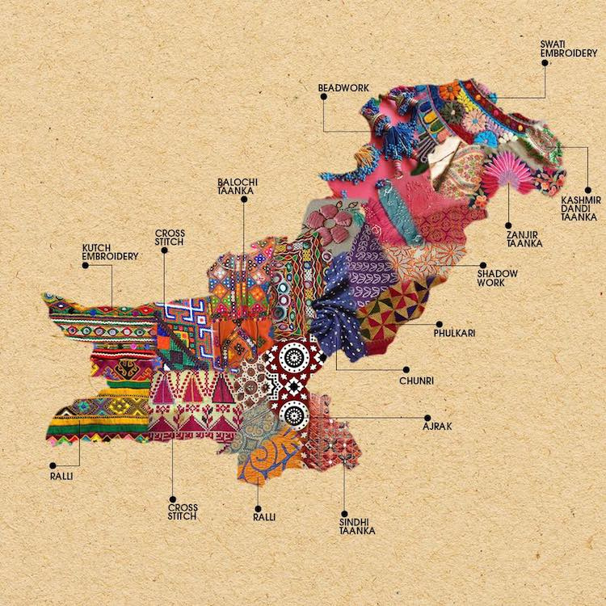
INTRODUCTION:
Pakistan, situated in South Asia, is a land of breathtaking landscapes, historical treasures, and a fascinating mix of traditions. It is a country that proudly showcases its diversity, encompassing various ethnic groups, languages, religions, and customs.
The purpose of this presentation is to delve deeper into the captivating world of Pakistani cultures, exploring their unique characteristics and highlighting the essence of what makes them truly special. By the end of this journey, we hope to foster a greater understanding and appreciation for the cultural mosaic that exists within Pakistan's borders
We will uncover the distinct features and traditions that have shaped the vibrant cultures of Pakistan. From its geographical diversity to its religious customs, from its colorful festivals to its exquisite arts, we will unravel the beauty and depth of Pakistani cultures

Slide 3
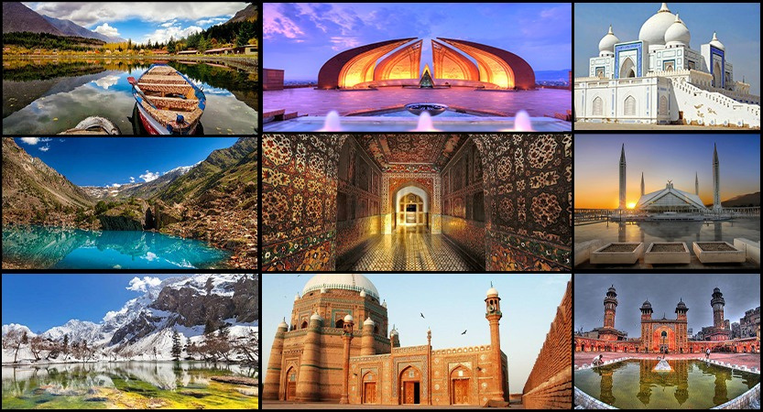
CONTENT TODAY
Geographical and Ethnic Diversity
Language and Communication
Religious Diversity
Festivals and Celebrations
Traditional Attire and Cuisine
Arts, Music, and Dance
Social Customs and Traditions
Conclusion
Presentation Design

Slide 4
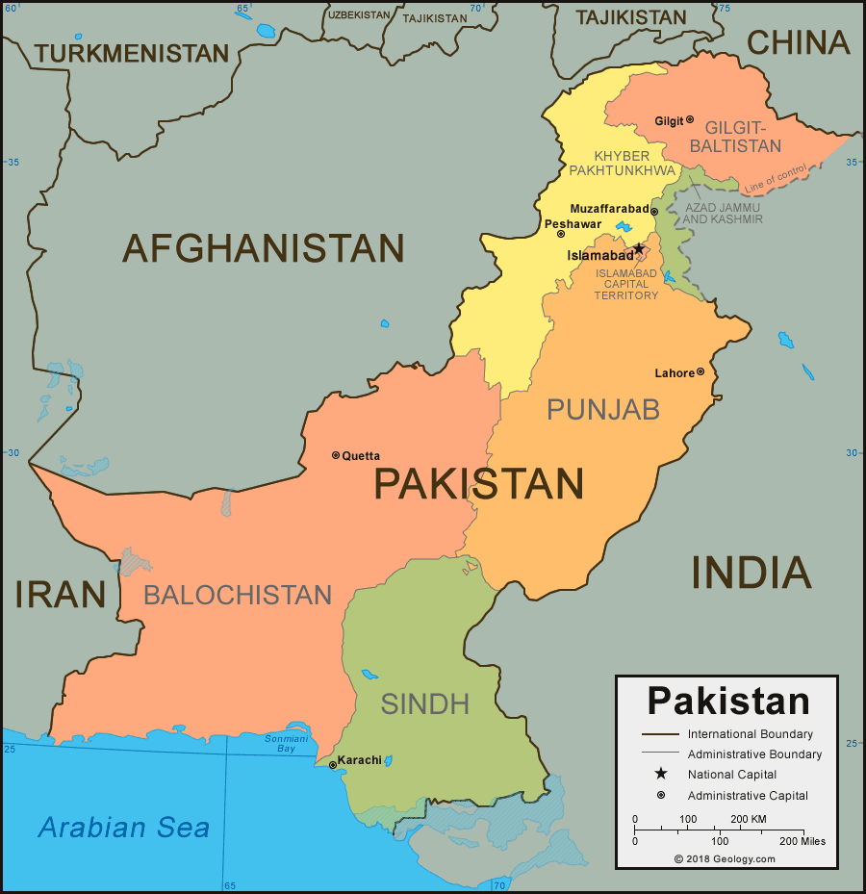
1.GEOGRAPHICAL AND ETHNIC DIVERSITY
Pakistan's geographical location is a key factor that has greatly influenced its cultural diversity. Situated in South Asia, it shares borders with Afghanistan, Iran, India, and China, resulting in a unique blend of traditions, languages, and customs.
The diverse topography of Pakistan plays a significant role in shaping its cultural landscape. From the mighty peaks of the Himalayas in the north to the vast plains of the Indus River in the south, Pakistan is blessed with a wide range of natural features. This geographical diversity has led to the emergence of distinct regional identities and cultural variations across the country.
Pakistan is home to numerous ethnic groups, each contributing to the tapestry of Pakistani cultures. The major ethnic groups include Punjabis, Sindhis, Pashtuns, Balochis, and many others. Each group has its own language, traditions, and customs, adding to the vibrant diversity that defines Pakistan.
In the northern regions, such as Gilgit-Baltistan and Khyber Pakhtunkhwa, the influence of Central Asian and Afghan cultures can be seen. The Punjabi culture dominates in the province of Punjab, while Sindh is known for its unique Sindhi culture. Balochistan, with its rugged landscape, boasts a distinct Balochi culture. These regional cultures, intertwined with the broader Pakistani identity, contribute to the rich tapestry of Pakistani cultures

Slide 5
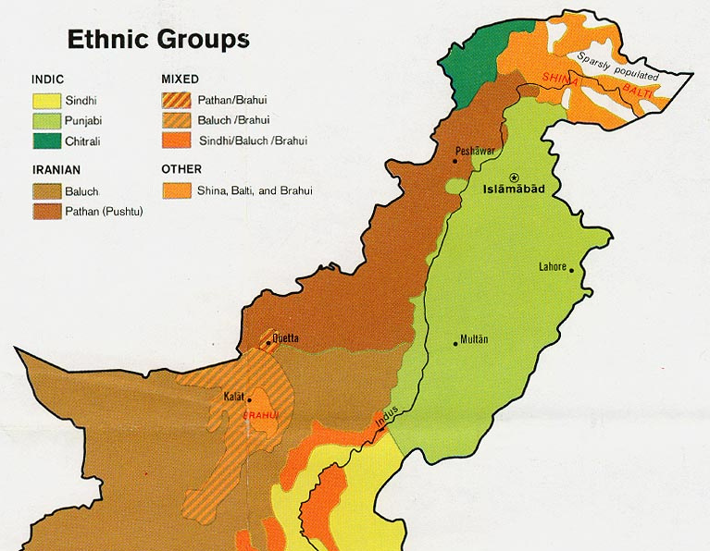
MAJOR ETHNIC GROUPS
Punjabis: The Punjabi ethnic group is the largest in Pakistan, primarily residing in the province of Punjab. Punjabi culture is known for its colorful traditions , lively folk music, and vibrant dance forms such as Bhangra and Giddha
Sindhi's: The Sindhi ethnic group primarily resides in the province of Sindh. Sindhi culture is deeply rooted in Sufism and is known for its rich poetry, music, and unique art forms such as Ajrak (a traditional block-printed fabric).
Pashtuns: The Pashtun ethnic group inhabits the northwestern regions of Pakistan, particularly Khyber Pakhtunkhwa and parts of Balochistan. Pashtun culture is characterized by a strong tribal system, hospitality, and the Pashto language. The Pashto music and dance forms, such as Attan, are integral parts of their cultural expression.
Balochis: The Balochi ethnic group predominantly resides in Balochistan. Balochi culture is deeply rooted in nomadic traditions and a strong sense of tribal identity. Their vibrant folklore, intricate crafts, and unique music are significant elements of Balochi culture.
Kashmiris: The Kashmiri ethnic group, primarily inhabiting the Kashmir region of Pakistan, contributes to the cultural richness of the country. Kashmiris have a unique language and cultural heritage. The Kashmiri language, with its rich literature and poetry, is an important aspect of their identity.
These are just a few examples of the major ethnic groups in Pakistan. However, it is essential to note that Pakistan is home to many other ethnic groups, including the Saraikis, Hazaras, Gilgitis, Baltis and many more

Slide 6
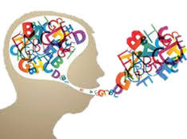
2.LANGUAGE AND COMMUNICATION
Urdu as the Official Language:
Urdu is the official language of Pakistan and holds great significance in the country. It serves as a unifying language, connecting people from diverse linguistic backgrounds. Urdu is a hybrid language, developed through the fusion of Persian, Arabic, and various regional languages. It acts as a medium of communication in government, education, media, and official settings. Urdu plays a vital role in fostering national unity and creating a sense of shared identity among Pakistanis.
Presentation Design

Slide 7
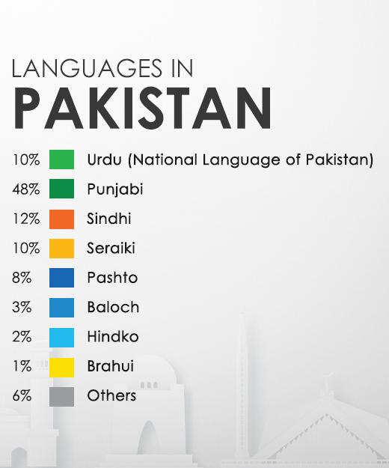
MAJOR LANGUAGES IN DIFFERENT REGIONS:
Pakistan is linguistically diverse, with various regional languages spoken across different regions. Some of the major languages include:
Punjabi: Spoken in Punjab, it is the most widely spoken language in Pakistan.
Sindhi: Primarily spoken in Sindh, it has a rich literary tradition and cultural significance.
Pashto: Predominantly spoken in Khyber Pakhtunkhwa and parts of Balochistan, Pashto is a language that reflects the region's cultural identity.
Balochi: Spoken in Balochistan, Balochi is an ancient language with its own distinct heritage.
Saraiki: Spoken in southern Punjab and parts of Khyber Pakhtunkhwa, Saraiki has a unique linguistic and cultural identity.
Kashmiri: Spoken in the Kashmir region of Pakistan, it is known for its poetic tradition and cultural significance.
These are just a few examples, but there are many other languages spoken in different regions, reflecting the diverse cultural tapestry of Pakistan.

Slide 8
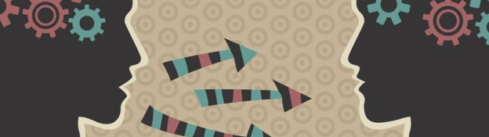
Language plays a crucial role in preserving and promoting cultural identity. It serves as a vehicle for transmitting traditions, customs, literature, and oral history from one generation to another. Regional languages hold deep connections to local cultures, and they reflect the values, history, and unique expressions of communities. By speaking and preserving their languages, people retain their distinct cultural identities and contribute to the rich diversity of Pakistani culture. Language allows for the expression of cultural nuances, enables communication within communities, and fosters a sense of belonging and pride.
IMPORTANCE OF LANGUAGE IN PRESERVING CULTURAL IDENTITY

Slide 9
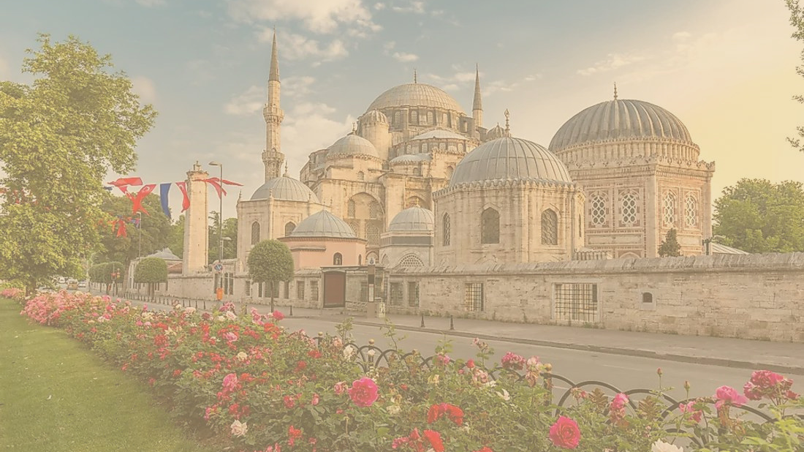
3.RELIGIOUS DIVERSITY
Islam as the Dominant Religion:
Islam is the dominant religion in Pakistan, with a significant influence on the country's culture and way of life. The majority of Pakistanis are Muslims, and Islamic principles and values shape various aspects of their daily lives. Islam plays a central role in shaping social customs, family structures, moral values, and legal frameworks. Islamic teachings have influenced art, architecture, music, literature, and cuisine, contributing to the distinct cultural identity of Pakistan.
Presentation Design

Slide 10
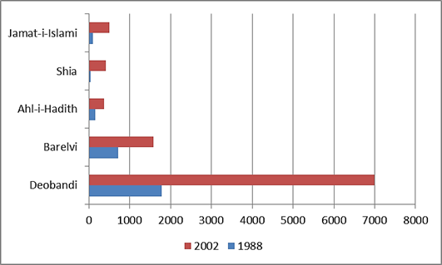
PRESENCE OF DIFFERENT ISLAMIC SECTS:
Pakistan is home to various Islamic sects, each with its own cultural practices and traditions. The major Islamic sects in Pakistan include Sunni and Shia Muslims, with sub-sects within each. While both sects share the core beliefs of Islam, they may have differences in certain religious practices, rituals, and interpretations of Islamic law. These differences can be seen in cultural expressions such as religious processions, mourning rituals, and specific commemorations associated with each sect.
Presentation Design

Slide 11
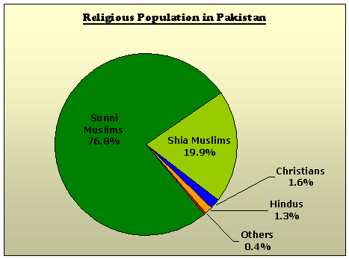
RELIGIOUS MINORITIES
Pakistan is also home to several religious minorities, including Christians, Hindus, Sikhs, and others. These religious communities contribute to the cultural diversity of Pakistan, enriching the social fabric with their distinct customs, traditions, and practices. Religious minorities have their own festivals, places of worship, and cultural celebrations. For example, Christians celebrate Christmas, Hindus observe Diwali, and Sikhs celebrate Gurpurab
The presence of religious minorities is protected by the Constitution of Pakistan, which guarantees freedom of religion and the right to practice and celebrate one's faith. The coexistence of different religious communities in Pakistan reflects a commitment to pluralism and tolerance.
In conclusion, Islam's dominant presence in Pakistan influences the country's culture, social norms, and values. The presence of different Islamic sects adds further diversity to cultural practices and expressions within the Muslim community. Additionally, religious minorities, such as Christians, Hindus, and Sikhs, contribute their own customs and traditions to the cultural tapestry of Pakistan. The coexistence of different religious communities in Pakistan promotes interfaith harmony and showcases the country's commitment to religious diversity.
Presentation Design

Slide 12
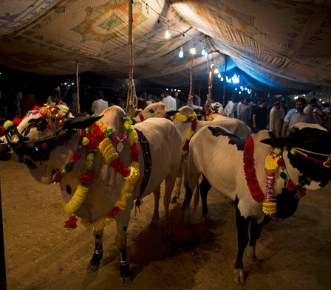
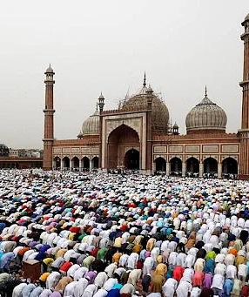
4.FESTIVALS AND CELEBRATIONS
MAJOR FESTIVALS IN PAKISTAN:
Pakistan celebrates various festivals that hold cultural and religious significance. Some of the major festivals include:
Eid-ul-Fitr: This festival marks the end of Ramadan, the holy month of fasting for Muslims. It is a joyous celebration that involves special prayers, family gatherings, exchanging gifts, and feasting on traditional sweets like sheer khurma. The festival showcases unity, generosity, and the spirit of giving.
Eid-ul-Adha: Also known as the Festival of Sacrifice, Eid-ul-Adha commemorates Prophet Ibrahim's willingness to sacrifice his son as an act of obedience to God. Muslims offer prayers, sacrifice animals, and distribute the meat among family, friends, and the less fortunate. It symbolizes devotion, charity, and compassion.
Ramadan: Ramadan is the holy month of fasting observed by Muslims worldwide. It is a time of self-reflection, prayer, and abstaining from food and drink from dawn to sunset. The month of Ramadan brings a sense of spirituality and communal harmony, with families gathering for pre-dawn meals (suhoor) and breaking their fasts together (iftar).
Presentation Design

Slide 13
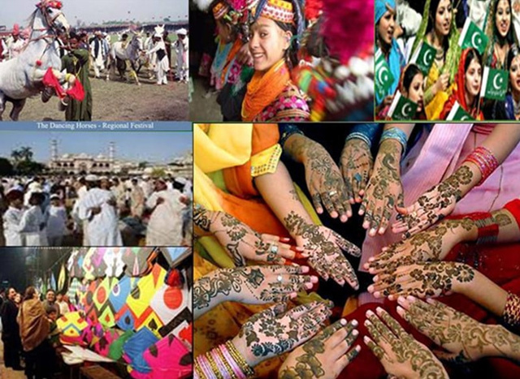
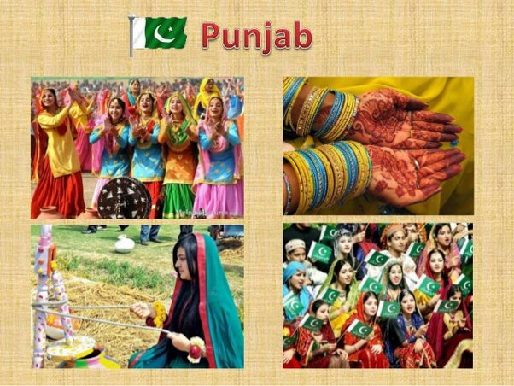
CULTURAL EVENTS AND TRADITIONS:
These festivals are celebrated with various cultural events and traditions, such as:
Traditional Clothing: People dress in their finest traditional attire during festivals. For example, men wear shalwar kameez, while women adorn colorful dresses like shalwar kameez or sarees, depending on the region.
Mehndi/Henna: Applying intricate henna designs on hands and feet is a common tradition, particularly during Eid celebrations and weddings. It adds a touch of beauty and artistry to the festivities.
Music and Dance: Festivals are often accompanied by lively music and traditional dance performances, such as the energetic Bhangra in Punjab or the graceful Attan in Khyber Pakhtunkhwa.
,
Presentation Design

Slide 14
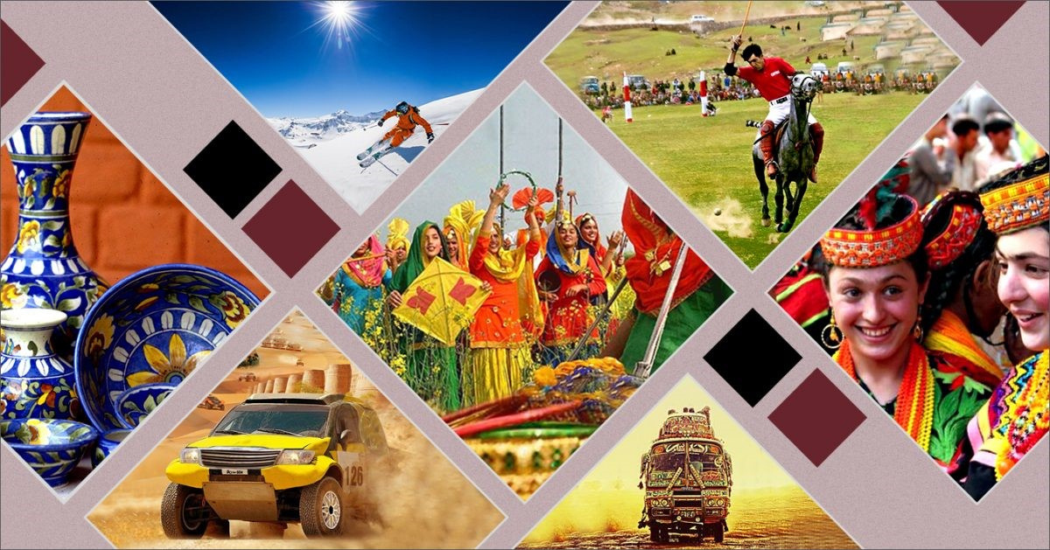
REGIONAL FESTIVALS:
Pakistan's diverse regions also have their own unique festivals, reflecting regional cultures and traditions. Some examples include:
Basant: Celebrated in Punjab, particularly in Lahore, Basant marks the arrival of spring. It involves kite flying competitions, musical performances, and traditional food.
Shandur Polo Festival: Held in Gilgit-Baltistan, this festival showcases the thrilling sport of polo played at the world's highest polo ground. It attracts local and international spectators.
Kalash Spring Festival (Chilimjusht): Celebrated by the Kalash community in Chitral, Khyber Pakhtunkhwa, this festival marks the arrival of spring with vibrant rituals, dance, and music.
Jashan-e-Baharan: Celebrated in Karachi, this festival welcomes spring with flower shows, cultural performances, and colorful processions.
These festivals and celebrations highlight the cultural diversity, regional customs, and traditions that make Pakistan a vibrant and festive nation. They bring people together, promote cultural pride, and foster a sense of unity and joy among the population.
Presentation Design

Slide 15
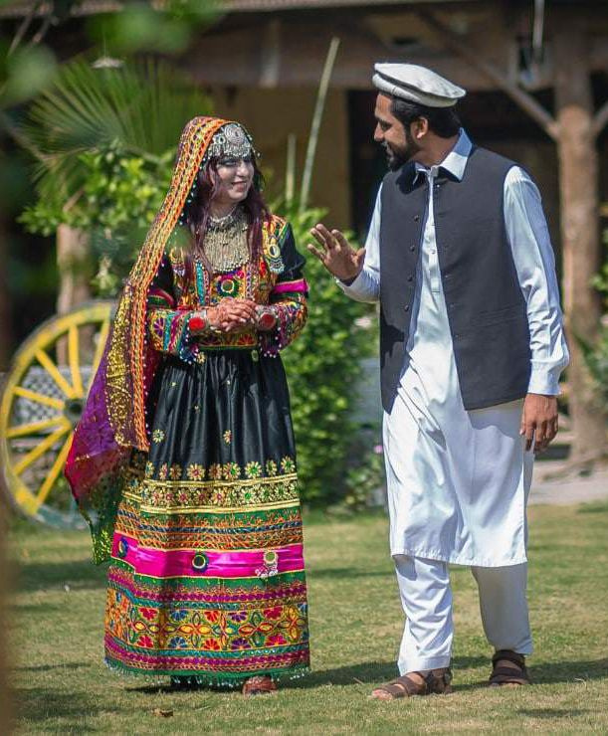
5.TRADITIONAL ATTIRE AND CUISINE
TRADITIONAL ATTIRE:
Pakistan's diverse regions are known for their distinctive traditional clothing styles. Some examples include:
Punjab: Traditional Punjabi attire for men includes the kurta, a loose-fitting tunic, paired with a shalwar, a baggy trouser. Women commonly wear the vibrant and colorful outfit called the Punjabi suit, consisting of a long shirt, wide trousers (shalwar), and a dupatta (scarf).
Sindh: The Sindhi cultural attire includes the Sindhi cap for men, along with a long loose shirt called kameez, paired with wide trousers (shalwar). Women traditionally wear the Sindhi dress, which is a colorful, heavily embroidered dress called ajrak.
Balochistan: Baloch men often wear the traditional dress known as the shalwar kameez, complemented by a loose-fitting cloak called a chapan. Women typically wear long, loose dresses with intricate embroidery and vibrant colors.
Khyber Pakhtunkhwa: Traditional Pashtun clothing includes the Khet partug, which is a loose-fitting shirt worn with baggy trousers. Men also wear the iconic Pashtun turban called the pagri or pakol cap. Women wear colorful, embroidered dresses with distinctive patterns.

Slide 16
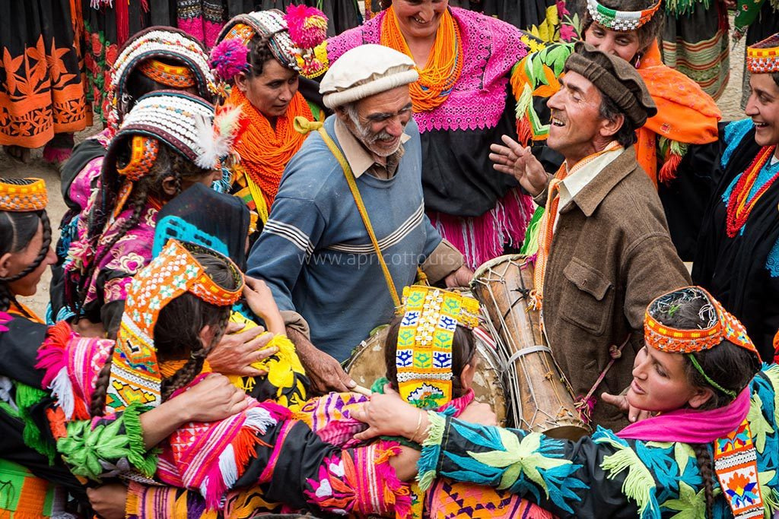
SIGNIFICANCE OF TRADITIONAL ATTIRE:
Traditional attire plays a crucial role in reflecting the cultural identity of different regions in Pakistan. It represents the rich heritage, values, and customs of specific communities. Traditional garments showcase the artistry of local artisans, with intricate embroidery, vibrant colors, and unique designs. They contribute to a sense of pride, belonging, and cultural expression, fostering a connection to one's roots and traditions.
Presentation Design

Slide 17
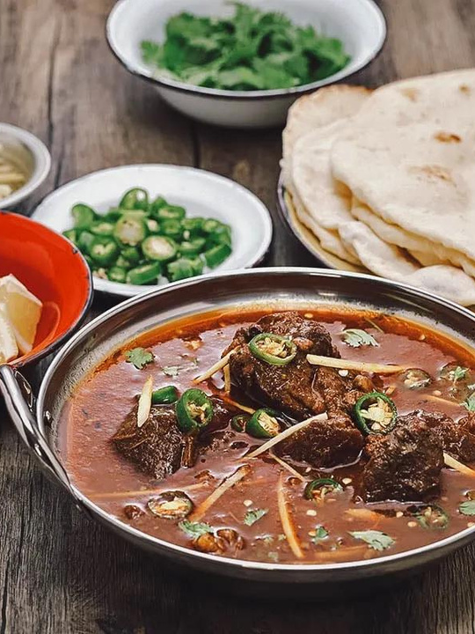
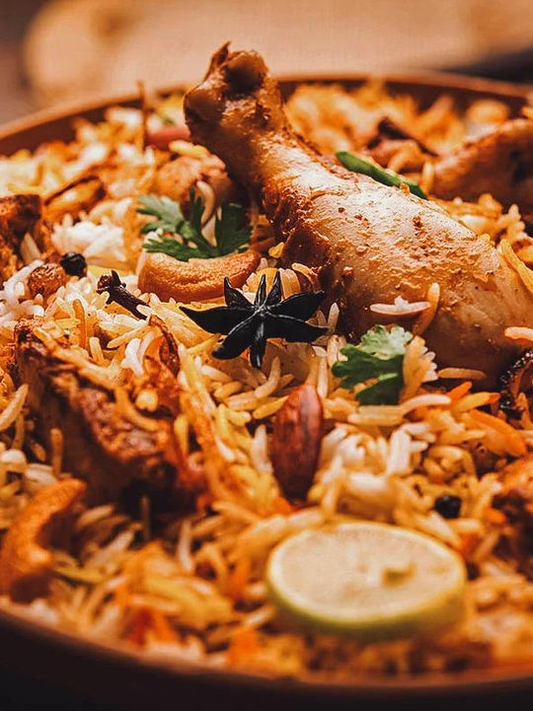
POPULAR PAKISTANI DISHES AND REGIONAL VARIATIONS:
Pakistan is renowned for its diverse and flavorful cuisine. Some popular dishes and their regional variations include:
Biryani: A fragrant rice dish cooked with meat, spices, and aromatic herbs. Variations include Sindhi Biryani, Lahori Biryani, and Hyderabadi Biryani.
Karahi: A savory and spicy dish prepared with meat, tomatoes, ginger, garlic, and a blend of aromatic spices. It is popular in Punjab and Khyber Pakhtunkhwa.
Haleem: A slow-cooked dish made with meat, lentils, and wheat, garnished with fried onions and served with naan bread. It is a specialty of Karachi and Hyderabad.
Nihari: A slow-cooked meat stew, often made with beef, simmered overnight with a blend of spices. It is a beloved dish in Lahore and other parts of Punjab.
Peshawari Chapli Kebab: A specialty of Peshawar, these flat, round kebabs are made from minced meat mixed with spices and are known for their rich flavors.
Sindhi Kadhi: A tangy and spicy yogurt-based curry, typically prepared with vegetables and gram flour. It is a staple dish in Sindh.
These are just a few examples, and Pakistani cuisine offers a wide range of flavors, ingredients, and regional specialties. The culinary diversity reflects the multicultural heritage of Pakistan and adds to its vibrant cultural tapestry.
Presentation Design

Slide 18
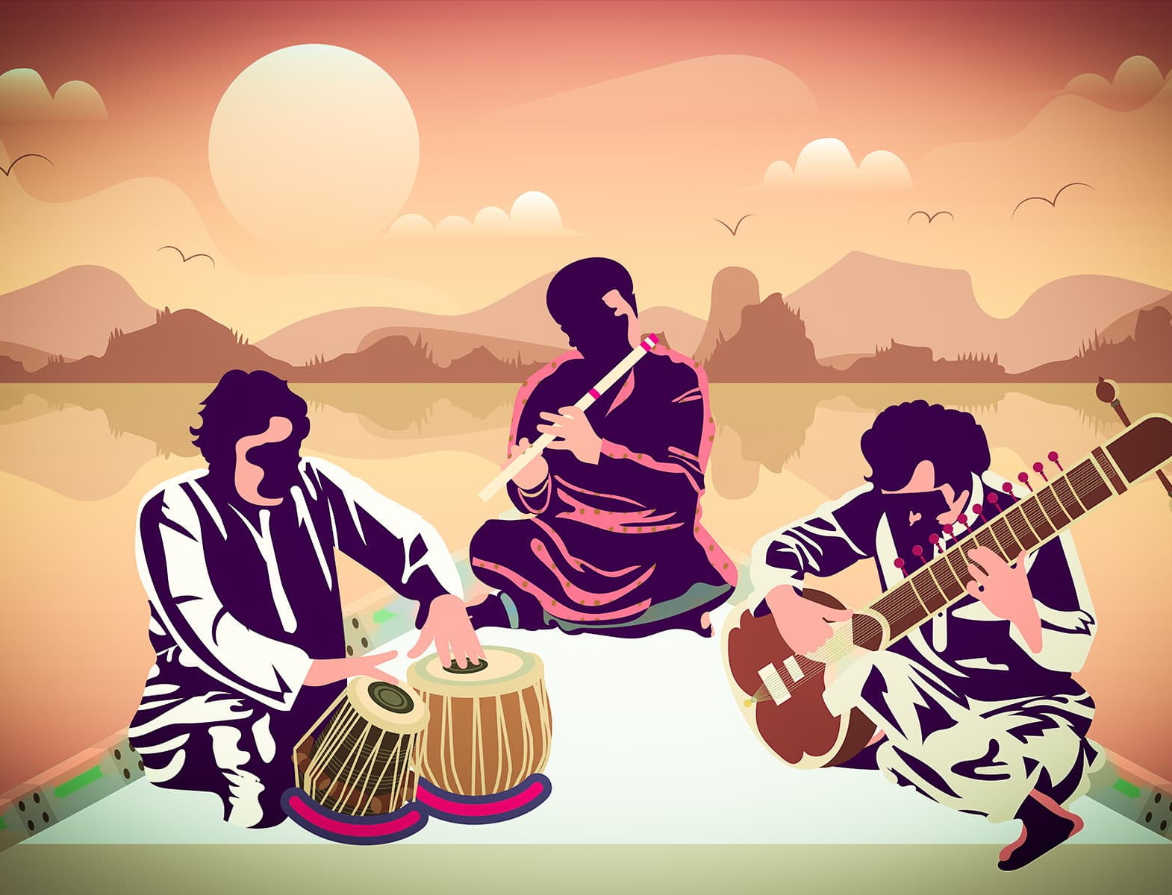
6.ARTS, MUSIC, AND DANCE
Importance of Arts, Music, and Dance in Pakistani Culture:
Arts, music, and dance hold immense significance in Pakistani culture, serving as expressions of creativity, identity, and emotions. They play a vital role in preserving traditions, promoting cultural heritage, and fostering a sense of community. Through various art forms, Pakistanis celebrate their history, social values, and collective experiences, showcasing the richness and diversity of the nation's cultural tapestry.
Presentation Design

Slide 19
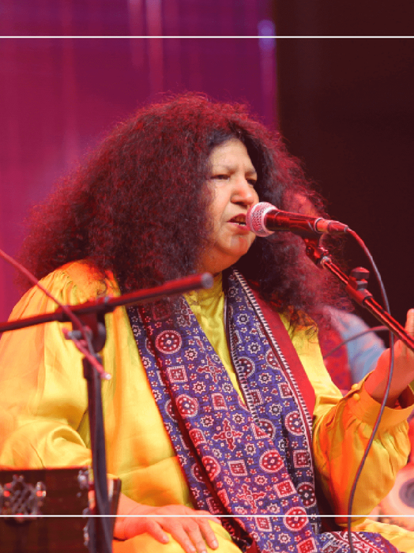
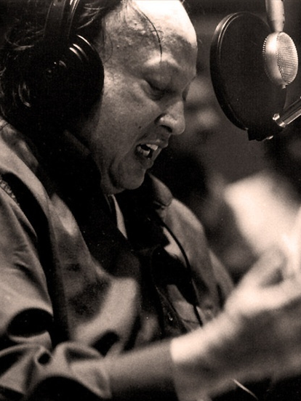
FAMOUS PAKISTANI MUSICIANS, ARTISTS, AND THEIR CONTRIBUTIONS:
Pakistan is home to many renowned musicians and artists who have made significant contributions to their respective fields. Some notable names include:
Nusrat Fateh Ali Khan: A legendary qawwali singer who popularized the genre both nationally and internationally.
Abida Parveen: A prominent Sufi singer known for her soul-stirring performances and mastery of various musical forms.
Mehdi Hassan: A renowned ghazal maestro whose melodious voice captivated audiences worldwide.
Reshma: An iconic folk singer known for her powerful vocals and renditions of traditional folk songs.
Sadequain: A celebrated painter known for his distinct artistic style and contribution to Pakistani visual arts.
Faiz Ahmed Faiz: A prominent poet and writer who contributed significantly to Urdu literature and poetry.
These individuals, among many others, have left an indelible mark on Pakistani arts and music, shaping the cultural landscape and inspiring future generations.
Presentation Design

Slide 20
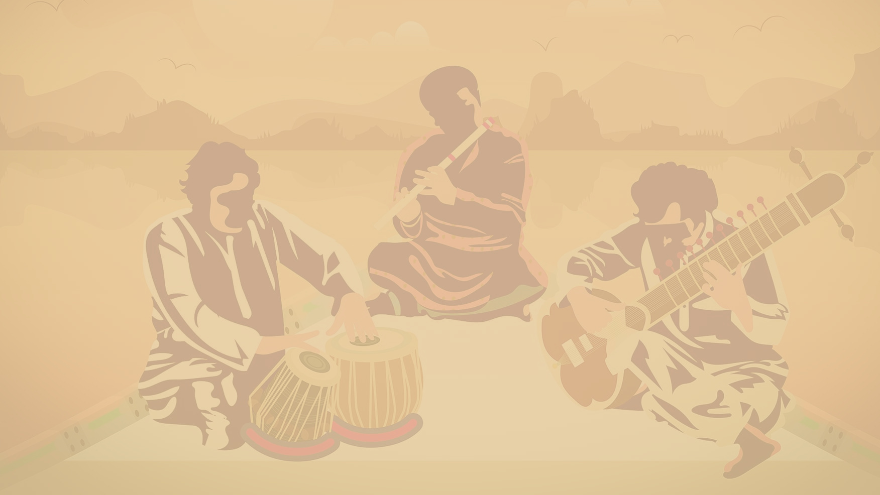
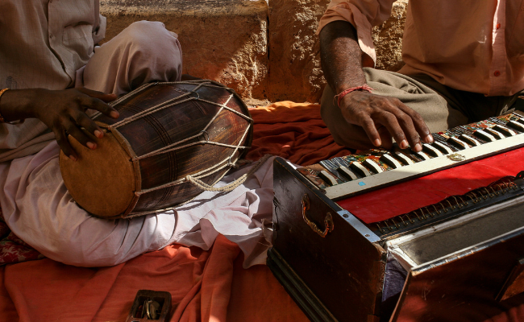
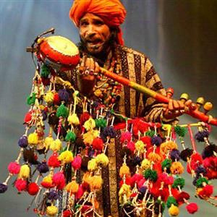
TRADITIONAL MUSIC GENRES:
Pakistan has a rich tradition of various music genres, each with its own unique characteristics. Some prominent traditional music genres include:
Qawwali: A devotional and mystical form of music rooted in Sufi traditions. Qawwali is characterized by powerful vocals, repetitive melodies, and rhythmic patterns that create a mesmerizing spiritual experience.
Ghazals: A poetic form of music that combines Urdu poetry with soulful melodies. Ghazals are known for their lyrical depth, expressing themes of love, longing, and spirituality.
Folk Music: Each region in Pakistan has its own folk music traditions, reflecting local customs and cultural influences. Folk music incorporates a variety of instruments, melodies, and rhythms, telling stories of rural life, love, and folklore.
Classical Music: Pakistan has a rich classical music tradition rooted in the subcontinent's heritage. Classical music includes genres such as Hindustani classical and Carnatic music, with renowned classical musicians preserving and promoting these art forms.
These traditional music genres continue to thrive in Pakistan, connecting people across generations and providing a deep appreciation for the country's cultural heritage.
Presentation Design

Slide 21
7.SOCIAL CUSTOMS AND TRADITIONS
Important Customs and Traditions:
Traditional Ceremonies:
Significance of Family and Community Bonds:
Pakistani society is rich in customs and traditions that shape social interactions and relationships. Some important customs include:
Hospitality: Pakistanis are known for their warm hospitality and welcoming nature. Guests are treated with great respect and are offered food and refreshments as a gesture of hospitality.
Respect for Elders: Respect for elders is deeply ingrained in Pakistani culture. Younger generations show reverence and obedience to their elders, seeking their guidance and wisdom.
Arranged Marriages: Arranged marriages are prevalent in Pakistani society, where families play a significant role in finding suitable life partners for their children. These marriages are based on compatibility, family background, and shared values.
Pakistan has various traditional ceremonies that hold cultural and religious significance. Some examples include:
Weddings: Pakistani weddings are elaborate and vibrant affairs, lasting multiple days and involving numerous pre-wedding, wedding, and post-wedding rituals. These ceremonies showcase traditions, music, dance, and intricate wedding attire.
Religious Rituals: Pakistan is an Islamic country, and religious rituals are an integral part of people's lives. These include daily prayers, Friday congregational prayers at mosques, and religious festivals such as Eid-ul-Fitr and Eid-ul-Adha, which involve special prayers, family gatherings, and acts of charity.
Family and community bonds are highly valued in Pakistani society. The family unit holds a central place, and extended families often live together or in close proximity, fostering a strong sense of kinship and support. Community ties are also significant, with neighbors and friends coming together during times of celebration or need.
Family Support: Family members provide emotional, financial, and social support to one another, emphasizing the importance of unity and shared responsibility.
Community Cohesion: Pakistani communities are characterized by a strong sense of togetherness. People come together for festivals, religious events, and community service, strengthening social bonds and fostering a sense of belonging.
These customs, traditions, and strong family and community bonds contribute to the social fabric of Pakistan, emphasizing the importance of relationships, respect, and collective well-being.
Presentation Design

Slide 22
Conclusion:
Pakistani cultures are diverse, dynamic, and deeply rooted in tradition. They reflect the richness of history, regional influences, and the shared values of its people. As we conclude this presentation, let us encourage further exploration and appreciation of Pakistani cultural heritage. By learning more about Pakistani cultures, we can foster cross-cultural understanding, celebrate diversity, and strengthen our connections as global citizens.

